Slide 1
Goals
Construct artificial operons with (1) re-wired regulation, (2) gene composition (using re-coded genes from other organisms where it makes sense), (3) elements of alternative pathways (so far possible in lysine biosynthesis, may be elsewhere)
Demonstrate that by modulating expression by artificial controls, we can achieve (1) near-optimal growth rate in minimal media, (2) decent level of production of target AA.
Generate mid-throughput datasets contaning metabolic and gene expression data (RNA-Seq and reporters)
Proof-of-principle for (1) our ability to introduce into an organisms a complex gene system and optimize its functions, (2) demonstration of industrial potential of “from-scratch” approach for bio production, (3) a big step towards construction of a complete synthetic designer organism)

Slide 2
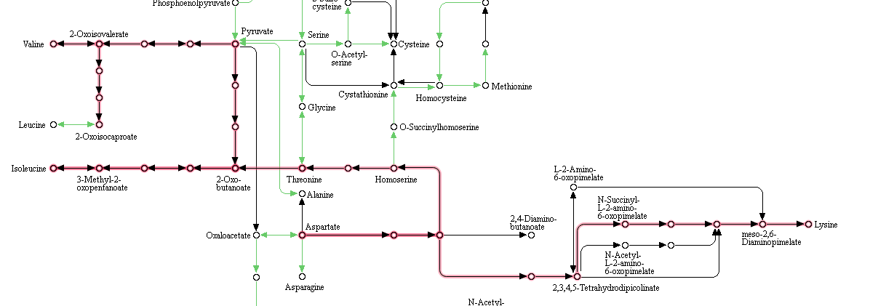
6 (4)
8
(4)
7
(3)
5 (6)
3 (2)
2 (1)
4 (7)
1 (2)
Black – reactions anywhere in KEGG
Green – E.coli
Red - E. coli pathways we want to modify

Slide 3
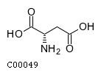
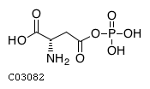
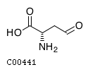
1
Aspartokinases I/II/III (thrA/metL /LysC)
EC:2.7.2.4
aspartate-semialdehyde dehydrogenase (asd)
[EC:1.2.1.11]
Aspartate
Phospho-L-aspartate
Aspartate 4-semialdehyde
Reverse
L-Aspartate 4-semialdehyde + Orthophosphate + NADP+ <=> 4-Phospho-L-aspartate + NADPH + H+
ATP + L-Aspartate <=> ADP + 4-Phospho-L-aspartate

Slide 4
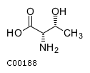
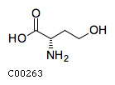
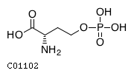
2+3
homoserine kinase
2.7.1.39 (thrB)
threonine synthase
4.2.3.1 (thrC)
homoserine dehydrogenase I/II
1.1.1.3 (thrA/metL)
homoserine phosphate
Threonine
Aspartate 4-semialdehyde
homoserine
homoserine
O-Phospho-L-homoserine + H2O <=> L-Threonine + Orthophosphate
L-Homoserine + NADP+ <=> L-Aspartate 4-semialdehyde + NADPH + H+ (reverse image)
homoserine
ATP + L-Homoserine <=> ADP + O-Phospho-L-homoserine

Slide 5
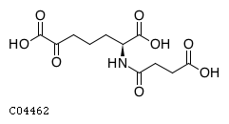
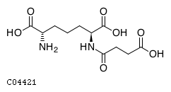
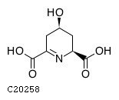
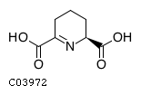
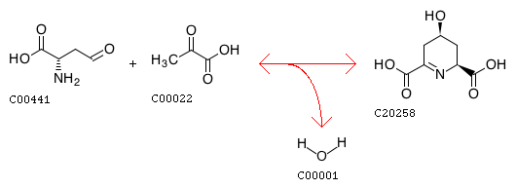
4a
4-hydroxy-tetrahydrodipicolinate reductase 1.17.1.8 (dapB)
acetylornithine/N-succinyldiaminopimelate aminotransferase 2.6.1.11** 2.6.1.17(argD)
dihydrodipicolinate synthase 4.3.3.7 (dapA)
tetrahydropyridine-2,6-dicarboxylate N-succinyltransferase 2.3.1.117 (dapD)
L-2,3,4,5-Tetrahydrodipicolinate
N-Succinyl-L-2-amino-6-oxopimelate
N-Succinyl-LL-2,6-diaminopimelate
Aspartate 4-semialdehyde
(2S,4S)-4-Hydroxy-2,3,4,5-tetrahydrodipicolinate
L-Aspartate 4-semialdehyde + Pyruvate <=> (2S,4S)-4-Hydroxy-2,3,4,5-tetrahydrodipicolinate + H2O
Succinyl-CoA + 2,3,4,5-Tetrahydrodipicolinate + H2O <=> CoA + N-Succinyl-2-L-amino-6-oxoheptanedioate
homoserine
2,3,4,5-Tetrahydrodipicolinate + NAD+ + H2O <=> (2S,4S)-4-Hydroxy-2,3,4,5-tetrahydrodipicolinate + NADH + H+ (or NADPH?)
N-Succinyl-LL-2,6-diaminoheptanedioate + 2-Oxoglutarate <=> N-Succinyl-2-L-amino-6-oxoheptanedioate + L-Glutamate

Slide 6
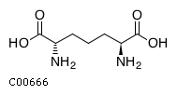
4b
succinyl-diaminopimelate desuccinylase 3.5.1.18 (dapE)
diaminopimelate epimerase 5.1.1.7 (DapF)
diaminopimelate decarboxylase 4.1.1.20 (lysA)
N-Succinyl-LL-2,6-diaminopimelate
Lysine
LL-2,6-Diaminopimelate
meso-2,6-Diaminopimelate
N-Succinyl-LL-2,6-diaminoheptanedioate + H2O <=> Succinate + LL-2,6-Diaminoheptanedioate
meso-2,6-Diaminoheptanedioate <=> L-Lysine + CO2
homoserine
LL-2,6-Diaminoheptanedioate <=> meso-2,6-Diaminoheptanedioate

Slide 7
5
ketol-acid reductoisomerase EC:1.1.1.86 (ilvC)
threonine deaminase (lyase) 4.3.1.19 (ilvA) (tdcB? dehydratase)
acetolactate synthase I/II/III large subunit 2.2.1.6 (ilvB /G /I) (H/M)
Threonine
2-Oxobutanoate(can come from Methylmalate)
Hydroxy-3-methyl-2-oxopentanoate
L-Threonine <=> 2-Oxobutanoate + Ammonia (EcoCys ads some spontaneous transformations)
Aceto-2-hydroxybutanoate
S)-2-Aceto-2-hydroxybutanoate <=> (R)-3-Hydroxy-3-methyl-2-oxopentanoate (same as next)
Pyruvate + 2-Oxobutanoate <=> (S)-2-Aceto-2-hydroxybutanoate + CO2
homoserine
2-Oxobutanoate + 2-(alpha-Hydroxyethyl)thiamine diphosphate <=> (S)-2-Aceto-2-hydroxybutanoate + Thiamin diphosphate

Slide 8
5b
ketol-acid reductoisomerase 1.1.1.86 (ilvC)
dihydroxy-acid dehydratase 4.2.1.9 (ilvD)
branched-chain amino acid aminotransferase 2.6.1.42 (ilvE)
Hydroxy-3-methyl-2-oxopentanoate
Isoleucine
Dihydroxy-3-methylvalerate
Methyl-2-oxopentanoate
2,3-Dihydroxy-3-methylpentanoate + NADP+ <=> (R)-3-Hydroxy-3-methyl-2-oxopentanoate + NADPH + H+
2,3-Dihydroxy-3-methylpentanoate <=> (S)-3-Methyl-2-oxopentanoic acid + H2O
homoserine
L-Isoleucine + 2-Oxoglutarate <=> (S)-3-Methyl-2-oxopentanoic acid + L-Glutamate (and all others)

Slide 9
6
The same as 5 + multiple transaminases
homoserine

Slide 10
8
The same as 5 + two more enzymes, needs work
homoserine

Slide 11
Immediate things
Chris :
Main question: Testable modeling-based suggestions (what can you propose for us to test?)
Technical: Other modules for these genes, besides highlighted
Effect of individual knock-outs according to flux analysis
Did I miss analogs capable of the same functions
Effect of super-production (may not be ready to answer?)
Marie
Choice and troubleshooting of expression systems
Gyorgy
Experimental set-up which allows to grow cells, flip regulatory switches and measure what we need
List of intermediates which are practical to measure
Poor-man RNA-seq data
Alex
Machine learning (so far in other parts of the project)
Mike
Choice of the host strain (K12 “wild type” and/or lysine (threonine) producing strain?)
Expression, RNA yields and fluctuation in +, -, super-producing ? conditions
Artificial operon design, what make sense to coregulate?
Philippe? (with Mike)
E. coli knock-outs experiment plan

Slide 12
Additional items
Combinatorial biochemistry, proof-of-principle teaser
Experimental validation of machine learning predictions of discreet properties: “missing functions”, thermostability, high/low expression levels
Feature-importance (machine learning) analysis of a set of sequenced E.coli strains producing threonine and possible experimental validation

Slide 13
experiment
From single operon to combinations
Variables
No continuous growth
3-4 separately regulated submodules / at least three discreet levels of regulation each/versus gradient) / 2-4 versions of pathways / 2 or more hosts / multiple constructs at gene level (allosteric regulation, other properties = thousand+ discreet objects
3 duplicates
Features: 100 - 4,000 expressed genes, 10-30 metabolites (Biogen device? Then much more
Time-course
Continuous growth

Slide 14
1.) What is the temporal expression pattern that must be induced optogenetically in our branched-chain amino acid pathway insertion strains to most resemble wild-type behavior?
2.) By deviating from wild-type expression patterns, can I push E. coli into unnatural states and observe new behaviors? (e.g. shifts in protein content and even composition due to amino acid imbalance, altered growth curves, enhanced metabolic activity in stationary phase, improved growth rates, improved branched-chain amino acid production rates).
3.) Can a computer automatically learn optimal expression patterns?
4.) Are there improved branched chain amino acid biosynthesis pathways that can be designed through the integration of heterologous genes?

